Slide 1
Cloud Formation and Air Masses

Slide 2
Clouds
Dew point-temperature at which air must be cooled to reach saturation.
Condensation-phase change from gas to liquid; only occurs at saturation.
Lifted Condensation Level-LCL; point at which condensation occurs.

Slide 3
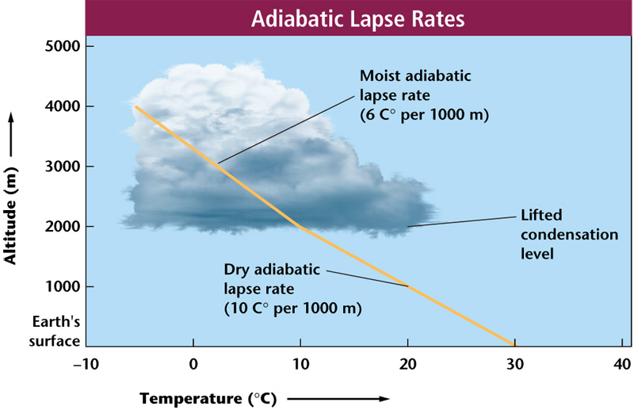

Slide 4
Cloud Formation
Air masses of different temperatures collide.
The less dense, warmer air mass rises over the more dense, colder air mass.
As the warm air rises, it cools, and once it reaches the LCL, water vapor will condense around condensation nuclei to become a cloud, if the density of condensation nuclei is great enough.
Condensation nuclei- particles in the air around which cloud droplets can form.

Slide 5
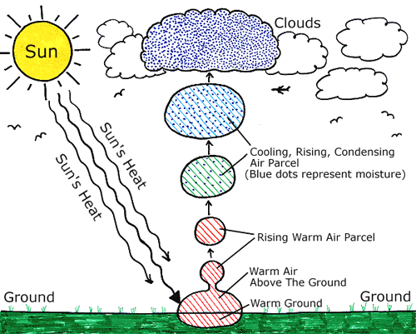

Slide 6
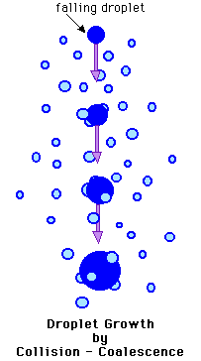
Precipitation
Coalescence-occurs when cloud droplets collide and join together to form a larger droplet.
When the droplet becomes too heavy to be held aloft, gravity takes over and it falls to Earth as precipitation.

Slide 7
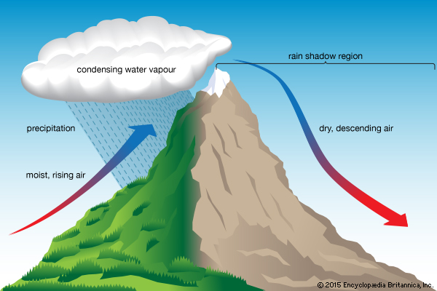
Another Method of Cloud Formation
Orographic Lifting - air mass is forced to lift due to topography, cooling down quickly in the process, causing condensation and cloud formation.

Slide 8
Meteorology
Weather-current state of the atmosphere.
Climate- describes the average weather over a long period of time
Examples?

Slide 9
Air Masses
A large body of air with similar
TEMPERATURE
HUMIDITY
Temperature
Warm
Cold
Humidity
Moist
Dry

Slide 10
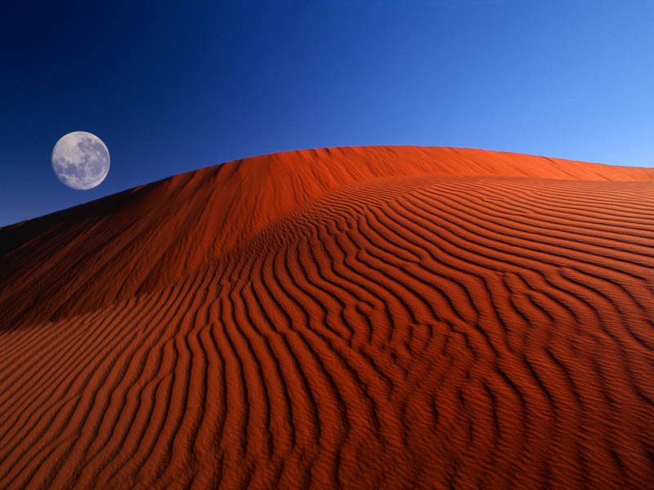
Air Masses’ Characteristics
Source Regions
Air Mass
Air Mass
Over land: drier.
Over water: more moist.

Slide 11
Types of Air Masses
DESCRIPTION CONDITION LOCATION FORMED
Maritime: (m) moist (marina/water)
Continental:(c) dry (continents/land)
Tropical: (T) warm (tropics)
Polar: (P) cold (poles)

Slide 12
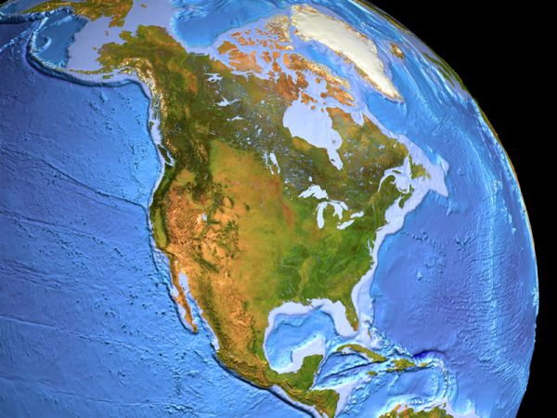
Types of Air Masses
cP Continental Polar
mP Maritime Polar
mP Maritime Polar
Dry, cold air to central and eastern US.
Moist, cold air to east areas of the Canada
Moist, cold air to west coast of the US.
mT Maritime Tropical
mT Maritime Tropical
Moist, warm air to west coast of the Mexico.
cT Continental Tropical
Moist, warm air to south east coast of the US.
Mr. Fetch's Earth Science Class
Dry, warm to Desert SW
Mr. Fetch’s Earth Science Classroom

Slide 13
Types of Air Masses
Maritime Tropical (mT)
Continental Tropical (cT)
Maritime Polar (mP)
Continental Polar (cP)
If we combine a temperature and humidity characteristic we can make
4 different types of air
masses.

Slide 14
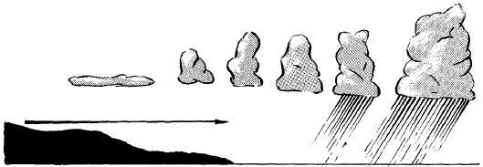
Air Mass Modification
Air masses move by prevailing winds. The winds cause the air masses to move over land and water. As the air masses move, they change. This is called air mass modification. The air masses become more like the area it is moving over…
At the same time, the area the air mass is moving over becomes more like the air mass.

