Slide 1
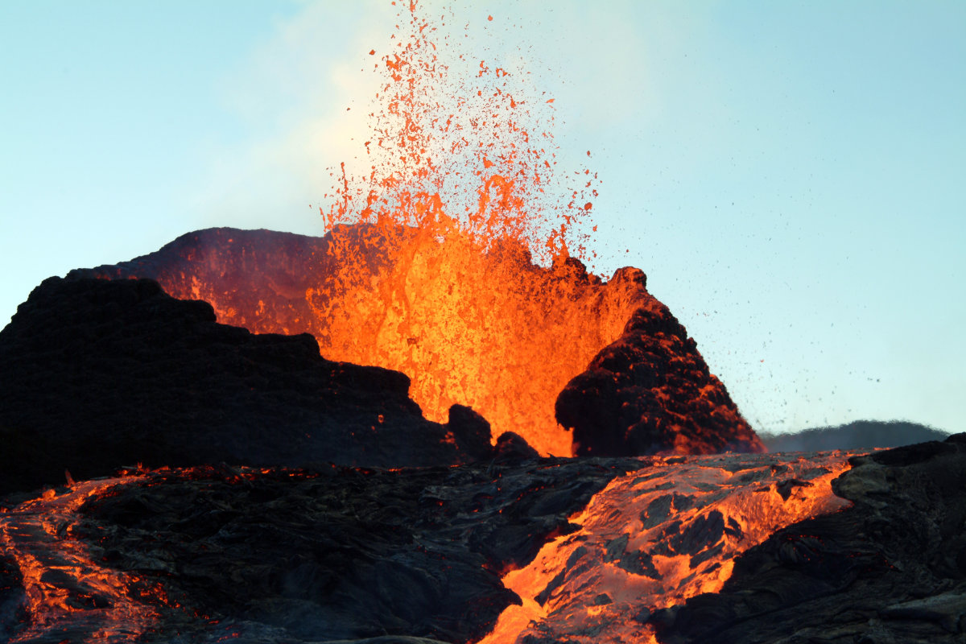
Earth’s Interior

Slide 2
The Lithosphere Unit
Lithosphere- (“rocky” sphere)- solid outermost shell of a rocky planet, includes the crust and the uppermost layer of the mantle

Slide 3
Evidence of the Interior
Direct evidence from rock samples–
Rocks drilled from deep inside Earth allow geologists to make inferences about conditions
Indirect evidence from seismic waves-
Seismic waves produced by earthquakes allow scientists to measure the speed in which they travel through solid or liquids

Slide 4
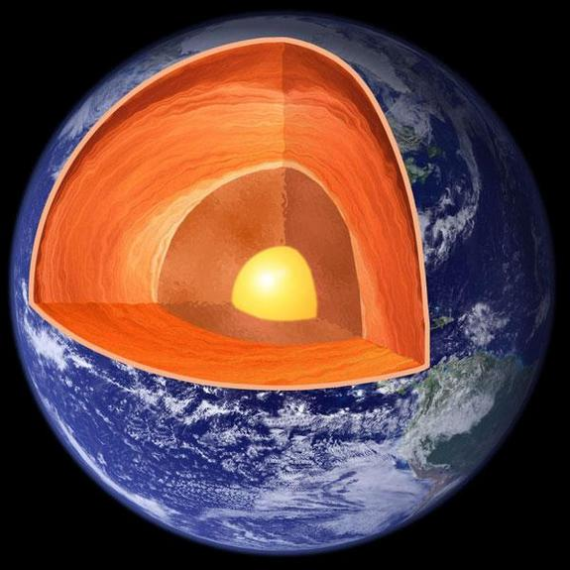
Earth’s Interior
The 3 main layers of Earth vary greatly in size, composition, temperature and pressure

Slide 5
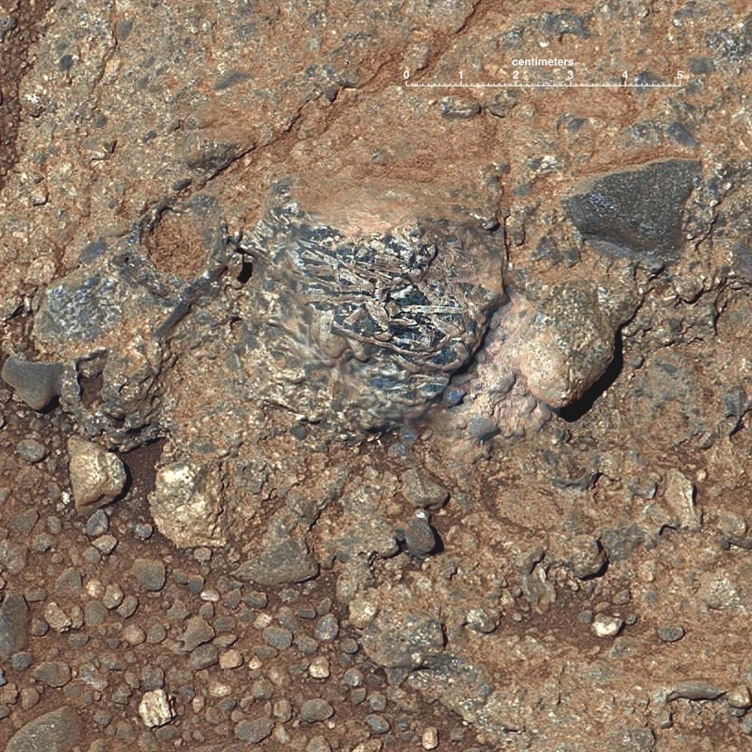
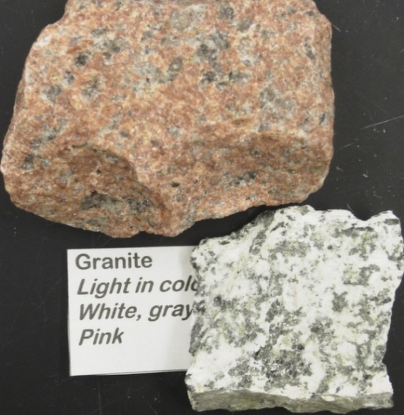
The Crust
Continental Crust–
Age: 4 billion years old
Color: light (pink, white and gray)
Rock Composition: granite
Thickness: 20-30 miles
Density: low density rock type composed almost entirely of silicates.

Slide 6
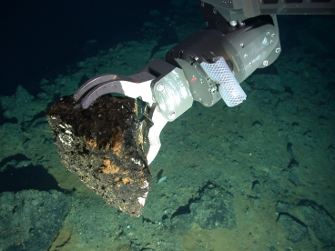
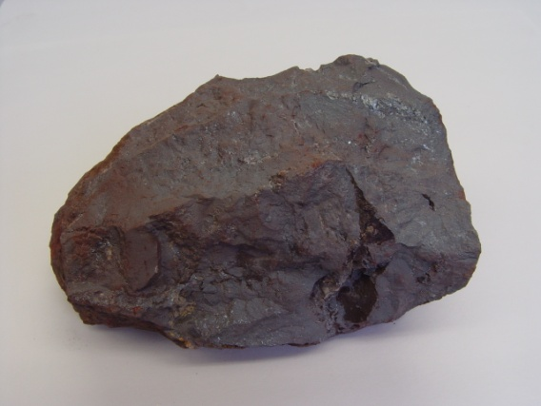
The Crust
Oceanic Crust–
Age: 180 million years
Color: dark (black)
Rock Composition: basalt
Thickness: 3-6 miles
Density: high density, composed of iron and magnesium

Slide 7
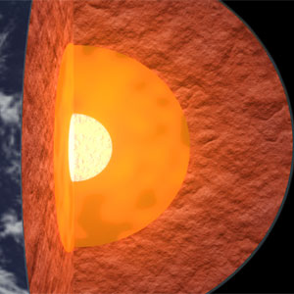
The Mantle
Layer of solid, hot rock 25 miles beneath the surface
Divided into layers
1.) Lithosphere- uppermost part of the mantle and the crust for a ridged layer about 60 miles thick
2.) Asthenosphere- softer plastic-like layer which is hotter and under increased pressure
3.) Lower mantle- solid material extending all the way to the mantle

Slide 8
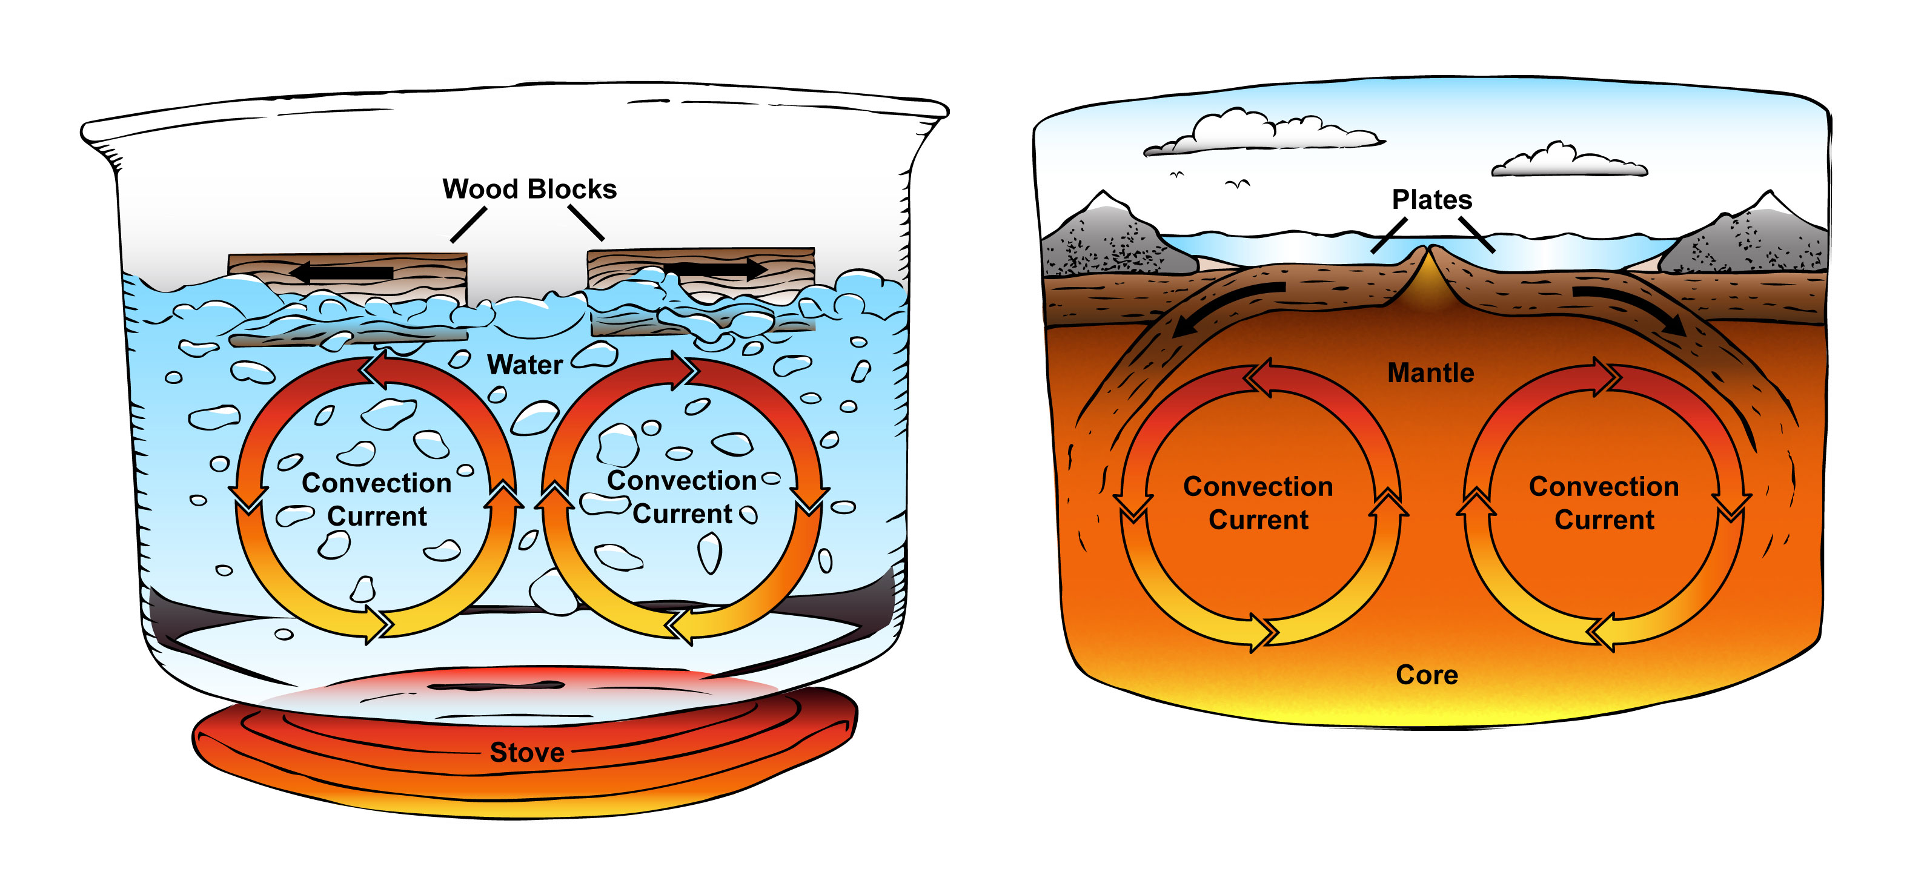
The Mantle- Convection Currents
CLICK HERE!

Slide 9
Slow motion of Earth’s mantle caused by the convection currents carrying heat from the interior of the Earth to the surface
HOT less dense material RISES
COOL more dense material SINKS
The Mantle- Convection Currents

Slide 10
The Core
Consists mostly of the metal IRON and NICKEL
Divided into two parts:
Outer Core- layer of molten liquid metal that surrounds inner core
Movement of liquid outer core creates Earth’s magnetic field
Inner Core- dense ball of solid metal
Natural decay of radioactive isotopes creates the heat inside Earth

