Slide 1
WELCOME to EARTH & ENVIRONMENTAL SCIENCE
Mr. Whitaker

Slide 2
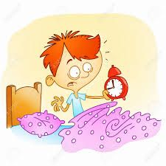
ATTENDANCE
show up to class!!!

Slide 3
Be PREPARED to learn!

Slide 4
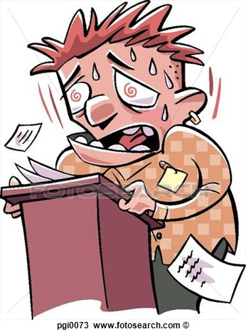
TRY your best!

Slide 5
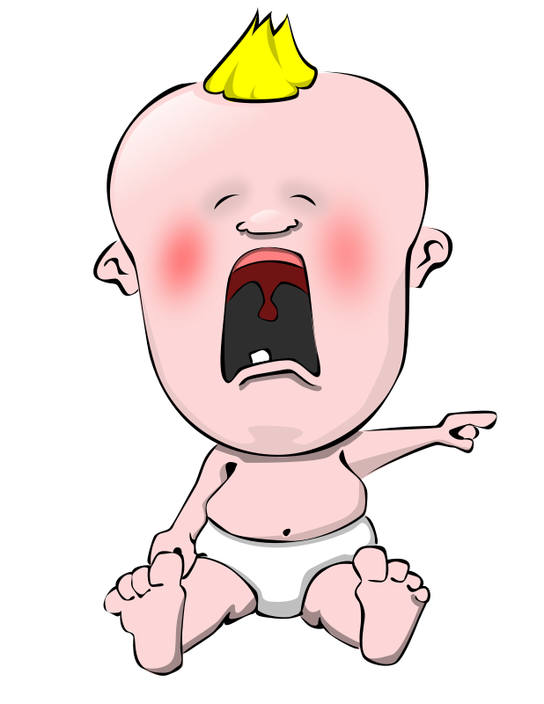

Slide 6
RAISE YOUR HAND
- to be recognized
- to get out of seat

Slide 7
In your seat when the bell rings!

Slide 8
NO food, drink, or gum

Slide 9
RESPECT
1.) yourself
2.) others
3.) classroom materials

Slide 10
Stay ORGANIZED

