Slide 1
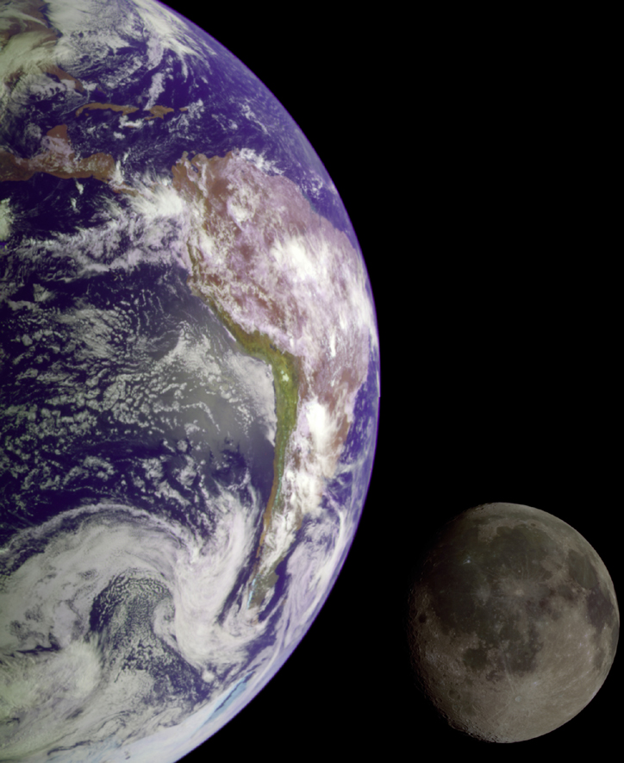
The Moon – Our Nearest Neighbor
A natural satellite
One of more than 96 moons in our Solar System
The only moon of the planet Earth

Slide 2
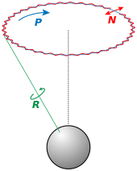
Nutation
Nutation (WOBBLE)
a small irregularity of the equinoxes.
caused exclusively by the moon
small changes in the location of the major circles of latitude
occurs over an 18 year period

Slide 3
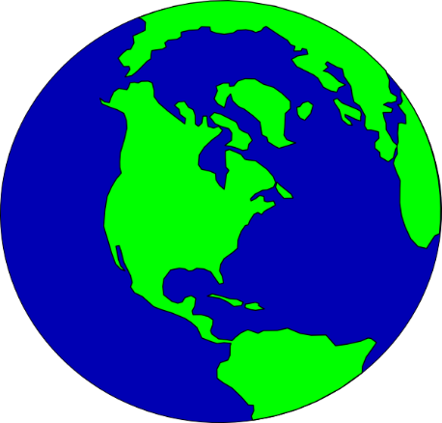
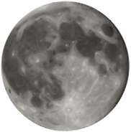
Barycenter
Center of Gravity- The exact center of all the material (that is, mass) that makes up an object—whether a planet or a pencil
Earth and the Moon, both bodies orbit around the center of the mass between them
is the center of mass of two or more bodies that are orbiting each other, or the point around which they both orbit

Slide 4
Stop to Summarize
1.) Do you think the Sun is stationary in our solar system? (think barycenter)
2.) Explain the difference between precession and nutation

Slide 5
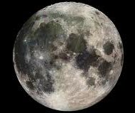
Movements of the Moon
Revolution – Moon orbits the Earth every 27 and 1/3 days
The moon rises in the east and sets in the west
The moon rises and sets 50 minutes later each day
Rotation – Moon turns on its axis every 27 days
Same side of Moon always faces Earth

Slide 6
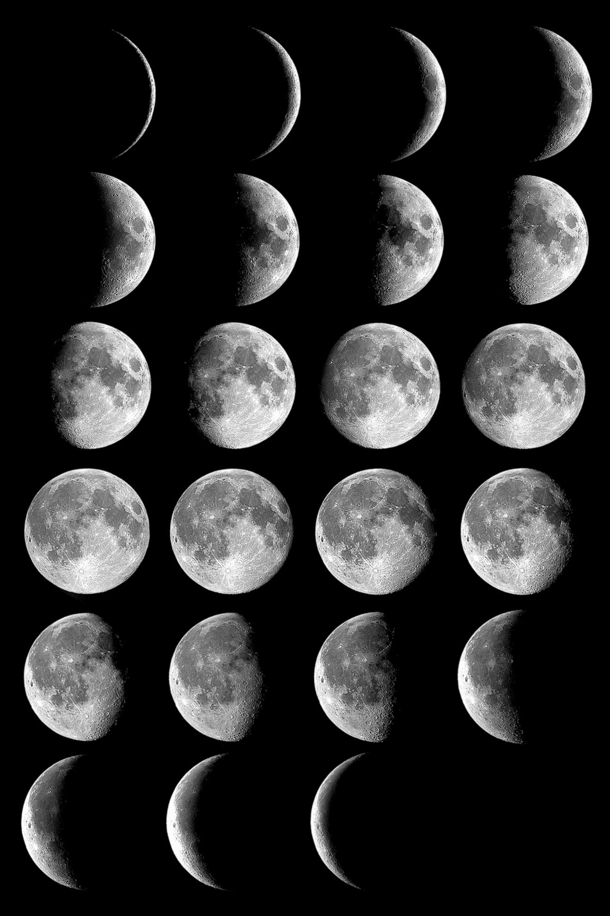
It’s Just a Phase
Moonlight is reflected sunlight
Half the moon’s surface is always reflecting light
From Earth we see different amounts of the Moon’s lit surface due to Earth’s rotation
The amount seen is called a “phase”

Slide 7
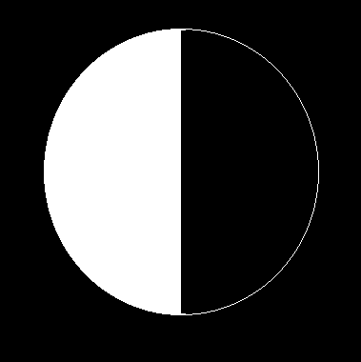
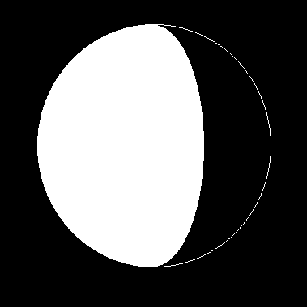
FOUR MAIN SHAPES
FULL
CRESCENT
QUARTER
GIBBOUS

Slide 8
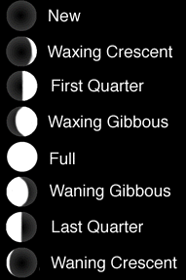

Slide 9
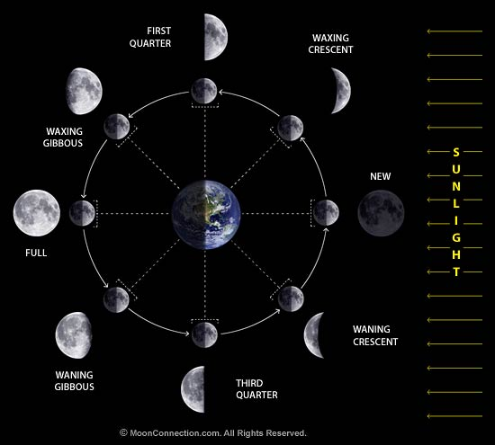
Phases of the Moon

Slide 10
Tides
Moon affects Earth by the formation of tides
Moon’s gravity pulls on Earth along imaginary line connecting Earth and the Moon
creates bulges of ocean water on both the near and far sides of the Earth
Earth’s rotation contributes to tide formation
As Earth rotates, these bulges align with the Moon

Slide 11
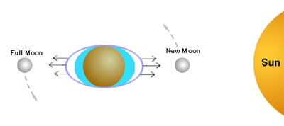
Tides
Spring=Strong
High tides are called spring tides and they are high when the Moon, Earth, and Sun are all aligned.
Occurs twice a month
New and Full moon phases

Slide 12
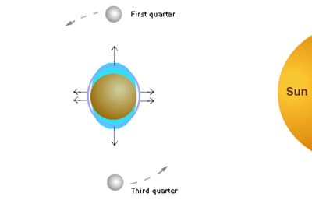
Tides
Neap= Weak
Low tides are called neap tides. They occur when the Earth, Moon, and Sun are at a 90 degree angle.
Occurs twice a month
First Quarter and Third Quarter Phases

Slide 13
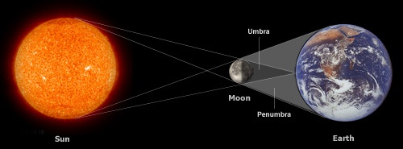
Solar Eclipses

Slide 14
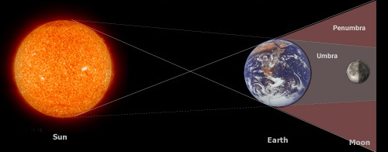
Lunar Eclipses

