Slide 1
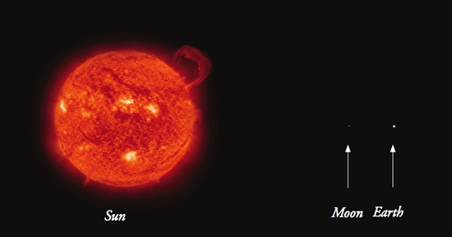
The Closest Star- Our Sun

Slide 2
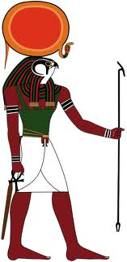
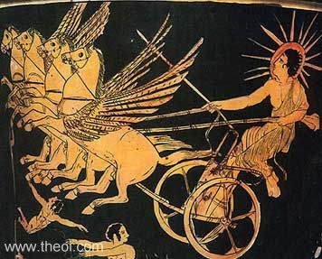
History of Our Sun
Worshipped as a deity (god) by many cultures throughout history
Called Helios by the Greeks
Called Ra by the Egyptians
Ra, the god of the Sun
Helios, Greek god
carrying the Sun to
its position in the sky

Slide 3
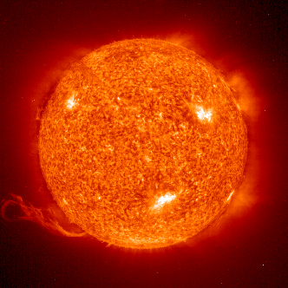
Why is the Sun important?
Supports life on earth by providing the temperature required for survival
Radiation- the transfer of thermal energy by electromagnetic waves.
Allows plants to grow via photosynthesis which in turn absorbs carbon dioxide and creates oxygen

Slide 4
How does the Sun produce light and heat?
Fusion occurs in the core of the Sun, where the pressure and temperature are extremely high.
Fusion is the combination of lightweight, atomic nuclei into heavier nuclei.
Fission is the opposite, which is the splitting of heavy atomic nuclei into smaller, lighter nuclei, like uranium into lead.

Slide 5
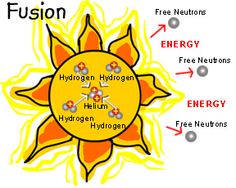
How does the Sun produce light and heat?
Deep in the sun's core, nuclear fusion reactions convert hydrogen to helium, which generates energy.
During fusion, hydrogen atoms are fused together to create a helium and release a tremendous amount of energy

Slide 6
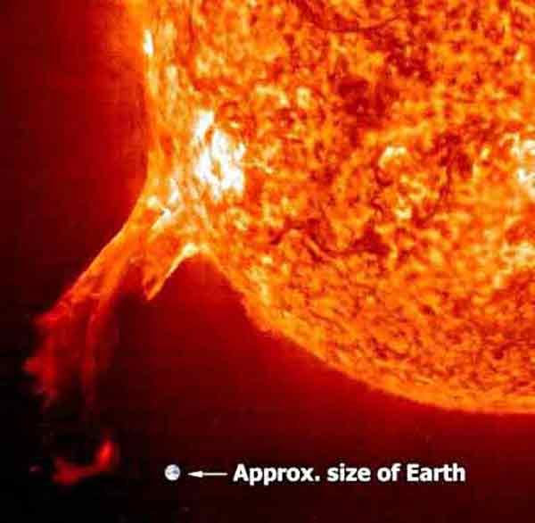
Features of the Sun – Solar Flares
Solar flare- a sudden and intense variation in brightness from a magnetic energy build up
IMPACT: radiation from past solar flares has been responsible for;
disrupting satellites
causing electronics and cellular devices to fail
causing telephone wires to burst into flames.

Slide 7
Features of the Sun – Solar Winds
Solar Winds- plasma flows outward from the corona at high speeds.
This wind of charged particles, called ions, flows towards all of the planets.
The ions are deflected by Earth’s magnetic field and trapped in two huge rings located at each of the Earth’s poles.
The high-energy particles in these belts collide with gases in the Earth’s atmosphere and cause the gases to give off light.

Slide 8
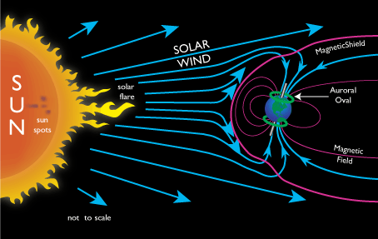
Features of the Sun – Solar Winds
This light, called the aurora, can be seen from Earth or from space.

Slide 9
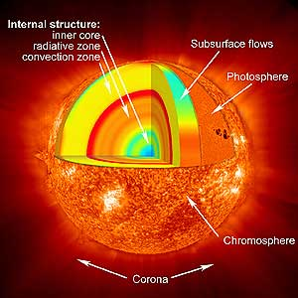
Outer Layers of the Sun
1.) Photosphere: star’s outer shell in which light is radiated
2.) Chromosphere: “sphere of color” next layer above the photosphere
3.) Corona: “crown” of light from the Sun

Slide 10
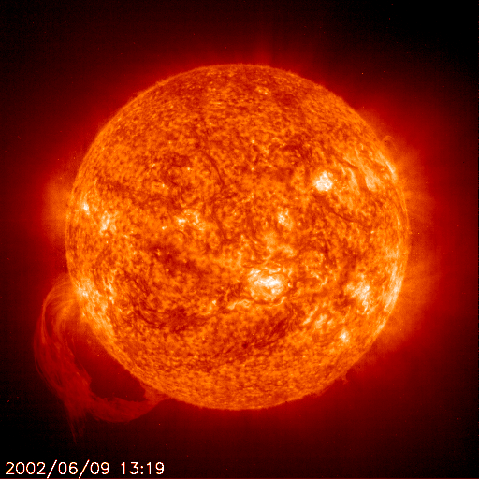
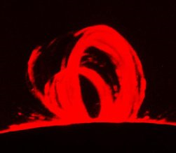
Features of the Sun – Prominence
Prominences are arcs of gas that are anchored in the photosphere layer of the Sun
Prominences extend through the corona layer of the Sun

Slide 11
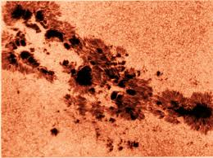
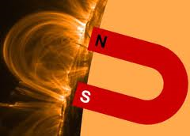
Features of the Sun – Sunspots
small, dark spots seen on the surface of the Sun
Sunspots are caused by strong magnetic fields on the Sun’s surface
One sunspot has North magnetic polarity and one sunspot has South magnetic polarity.
Caused by the Sun’s rotation

