Slide 1
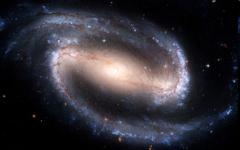
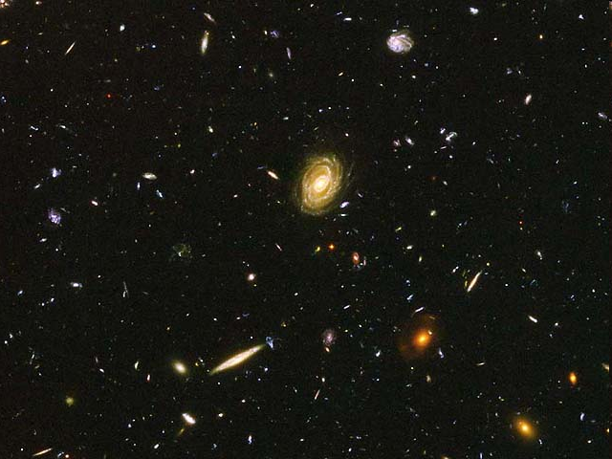
The Milky Way, Deep Space, and Beyond!

Slide 2
Hierarchy of the Universe
UNIVERSE
GALAXY (MILKY WAY)
STARS (SUN)
PLANETARY SYSTEM (SOLAR SYSTEM)
PLANET
(EARTH)

Slide 3
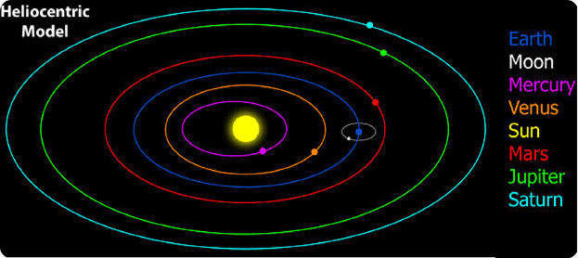
HELIO-centric=the Sun is at the center of our solar system
NOT
GEO-centric= the Earth is at the center of our solar system

Slide 4
Heliocentric Model
1543 Polish scientist Nicolaus Copernicus suggested Sun was center of solar system
First time a sun-centered or “heliocentric” model was proposed
In a heliocentric model, the inner planets move faster in their orbits than the outer planets do; as Earth bypasses a slower moving outer planet it appears the outer planet temporarily moves backward in the sky

Slide 5
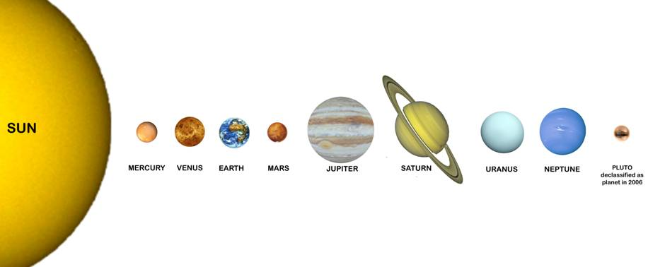
Our Solar System

Slide 6
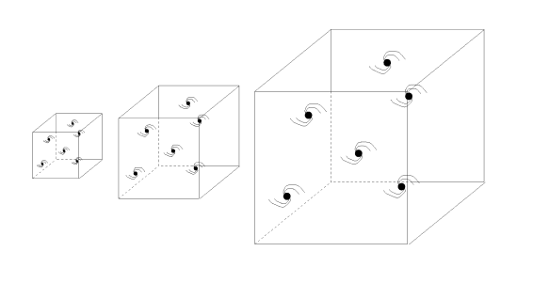
Big Bang Theory
Theory states that the universe began as a single point and has been expanding ever since

Slide 7
Misconceptions about the Big Bang Theory
1. The Big Bang was an explosion
2. The Big Bang Theory is an explanation for how the universe was created.
3. There is no evidence for the Big Bang Theory

Slide 8
Misconceptions about the Big Bang Theory
1. The Big Bang was an explosion.
-There was NO “BANG”
- Reality: space expands
When there is more space between galaxies, they “move” away from each other
Analogy: dots on an expanding balloon

Slide 9
Misconceptions about the Big Bang Theory
2. The Big Bang Theory is an explanation for how the universe was created.
Big Bang Theory explains how the Universe first started but leaves many unanswered questions
Time, Space and Matter were created in the Big Bang
Before the bang, there were no time, no space and no matter
Physics has not solved the question “What’s before the Big Bang”

Slide 10
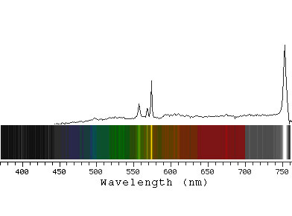
Misconceptions about the Big Bang
3. There is no evidence for the Big Bang Theory
Two main pieces of evidence:
(1) Red shift
(2) Cosmic background
radiation
The red shift is evidence
for an expanding universe

Slide 11
Red Shift
Doppler effect states if a source that is emitting waves moves away from us, the wavelength of the waves we receive from it will be longer
Therefore, if a star is moving AWAY from us, the wavelengths will be longer and red shifted
If a star is moving TOWARDS us, the wavelengths will be shorter and blue shifted

Slide 12
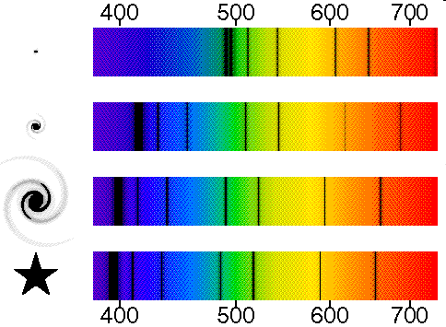
Red Shift
Notice how the pattern of absorption lines shifts from the blue end
to the red end as the galactic star becomes fainter. This is known as the Red Shift.

Slide 13
Kepler’s First Law
Ideas of Copernicus not originally accepted by scientific community, but within a century other astronomers found evidence to support the heliocentric model
Using accurate data of planetary observations, Kepler demonstrated each planet orbits the Sun in a shape called an ellipse instead of a circle

Slide 14
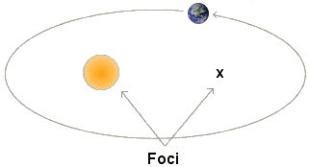
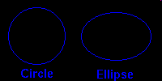
Kepler’s First Law
The orbits of planets are not circles but oval-shaped curves called ellipses!
The orbit of a planet is an ellipse with the Sun at one of the two foci.

Slide 15
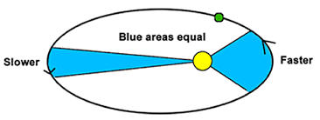
Kepler’s Second Law
A line joining a planet and the Sun sweeps out equal areas during equal intervals of time.
The Earth travels faster the closer it is to the Sun due to the gravitational pull.

