Slide 1
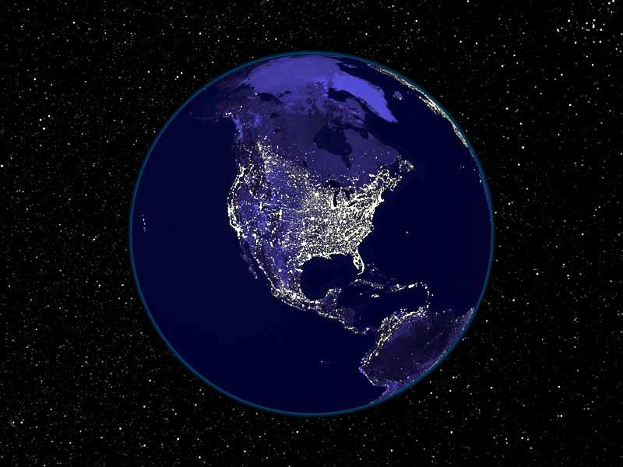
Tools of Astronomy

Slide 2
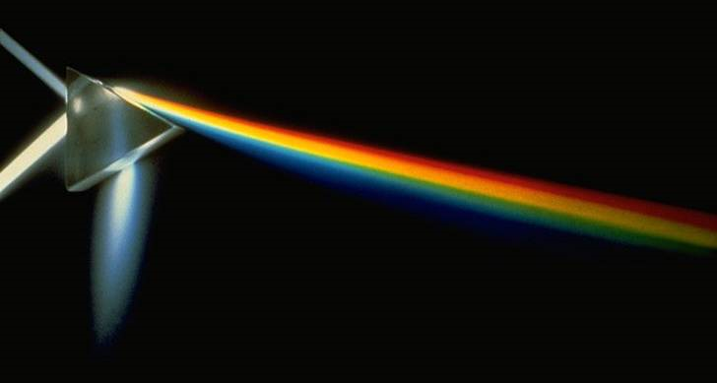
Light
In many cases, light from distant objects is the only tool that astronomers can use to learn about the universe
Light is a common term for electromagnetic radiation

Slide 3
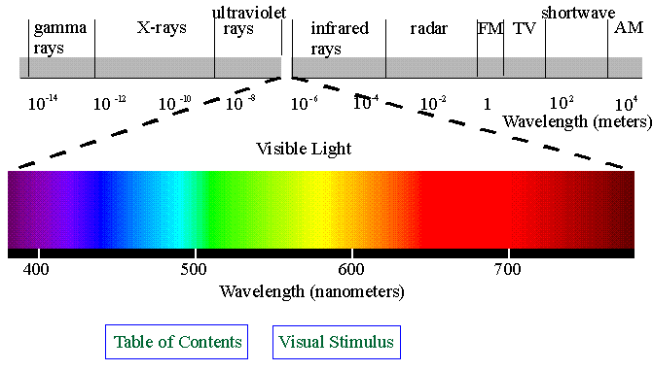
Electromagnetic Spectrum
Electromagnetic radiation consists of electric and magnetic disturbances traveling through space as waves
Includes visible light as well as: infrared and UV radiation, radio waves, microwaves, x-rays, and gamma rays

Slide 4
Electromagnetic Spectrum

Slide 5
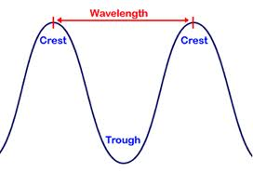
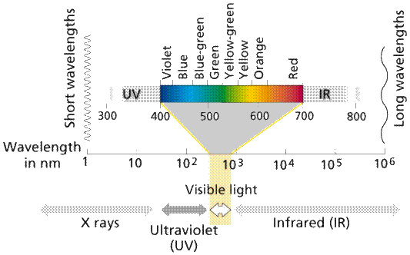
Electromagnetic Spectrum
Classified by its wavelength and frequency
Wavelength is the distance between peaks on a wave
*Red light has long wavelengths
*Blue light has short wavelengths

Slide 6
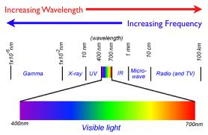
Electromagnetic Spectrum
Frequency is the number of waves that occur per second
*Blue light has a higher frequency than red light
*Notice that high frequency radiation is associated with more damaging effects on the human body

Slide 7
Telescopes
Objects in space emit radiation in all parts of the electromagnetic spectrum
The human eye can only see visible light, but telescopes can view all forms of radiation, giving us more information about objects in space
Two types of telescopes: refracting and reflecting

Slide 8
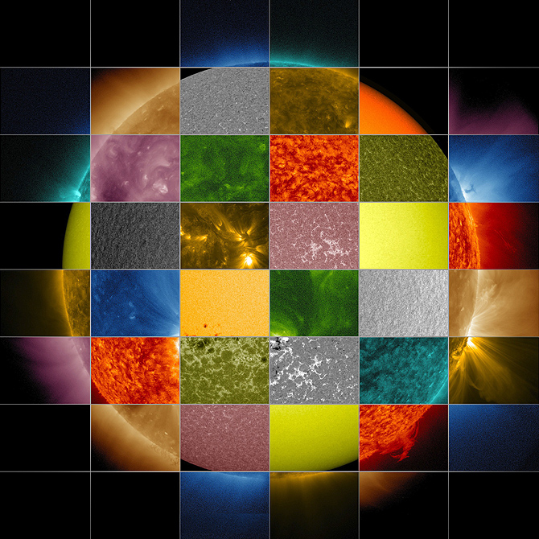
Different types of radiation provide different information about the Sun, from visualizing solar flares to determining which gases make up the star.

Slide 9
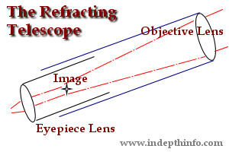
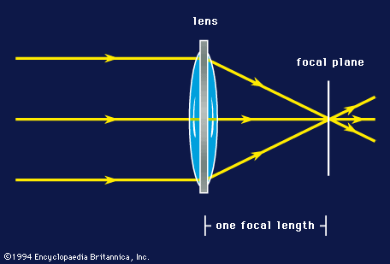
Refracting Telescopes
Refracting telescopes use a large lens called an objective lens to bring visible light into focus

Slide 10
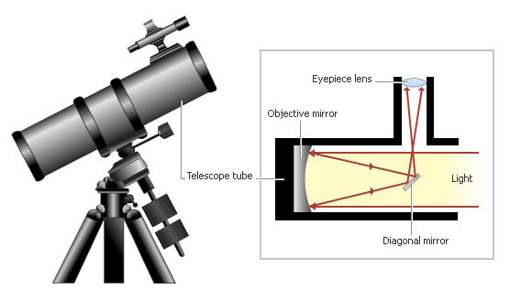
Reflecting Telescope
Reflecting telescopes use mirrors to focus visible light
Majority of telescopes used today are reflectors; like the famous Hubble telescope

Slide 11
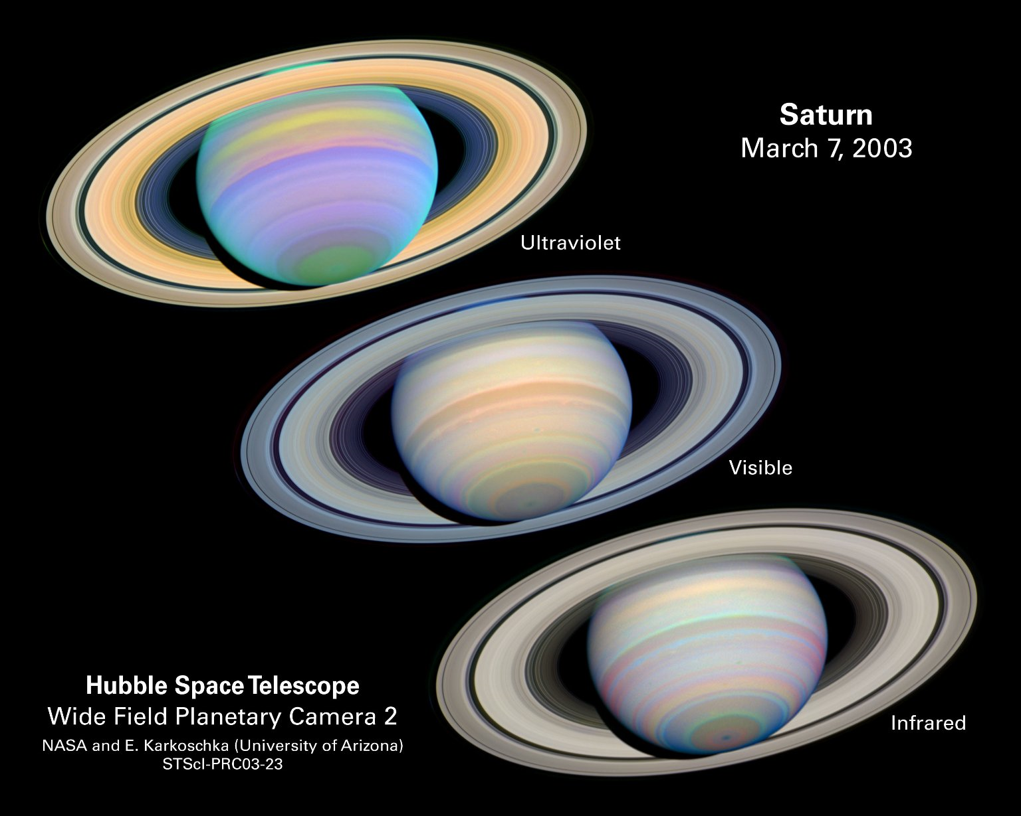
Images Captured by Telescopes

Slide 12
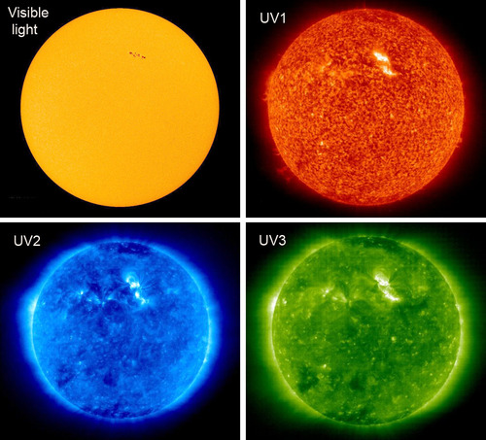
The Sun in Different Wavelengths

Slide 13
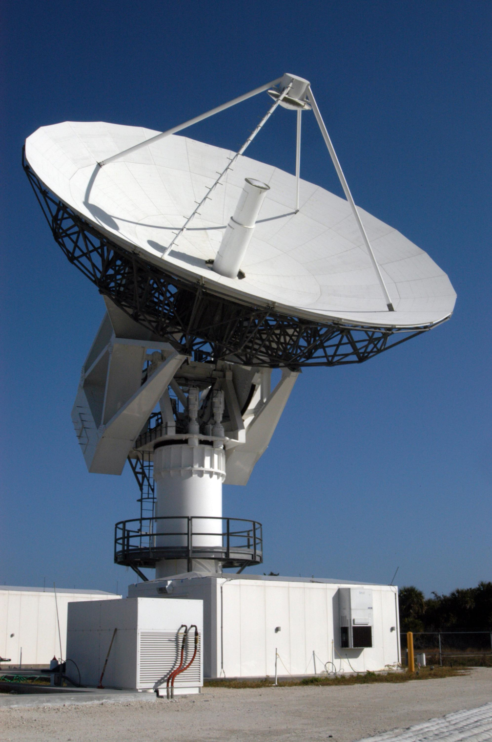
Radio Telescopes
A radio telescope is an consists of a radio receiver and an antenna system to detect radio-frequency radiation.
Radio telescopes must be very large in order to attain the resolution of optical telescopes.

Slide 14
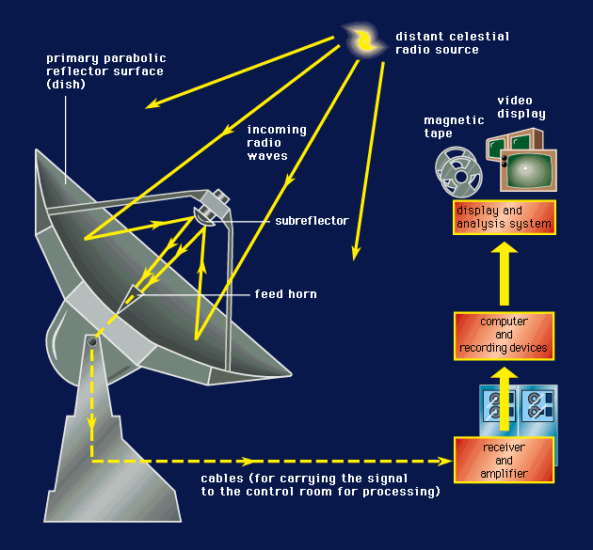
Radio Telescopes

Slide 15
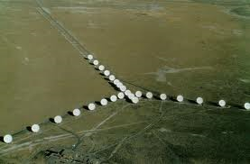
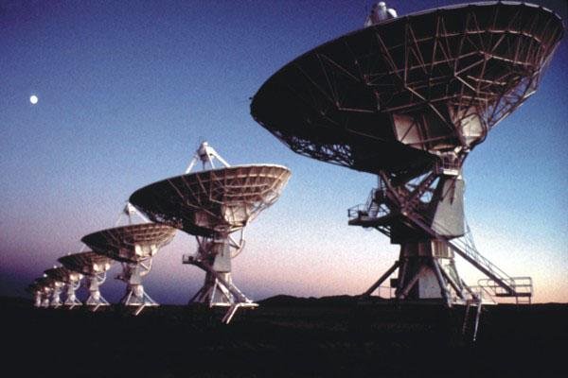
Interferometry
Interferometry is the process of linking separate telescopes together so that they act as one telescope. The detail in the image improves as the distance between the telescopes increases.

Slide 16
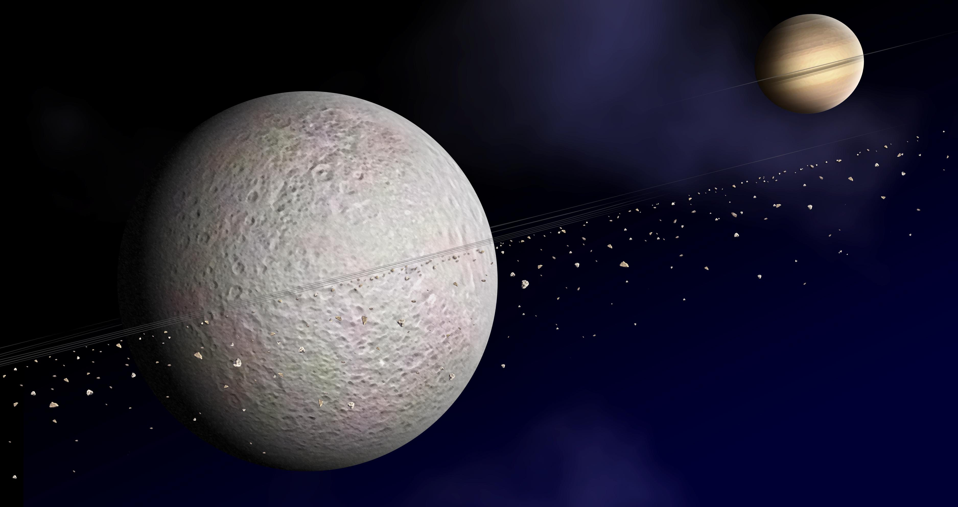
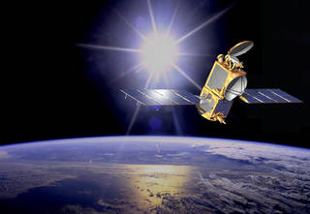
Satellites
Artificial- technology placed in orbit around the earth or moon or another planet in order to collect information or for communication
Natural- a celestial body orbiting a star or a planet, like our moon!

Slide 17
Space-Based Astronomy
Astronomers often have to send their instruments into space to collect the information they seek. This is due to:
(1) Earth’s atmosphere blocking radiation
(2) When radiation is allowed to pass through atmosphere, the images are blurred
(3) To make close-up observations
(4) To obtain samples from nearby objects in solar system

Slide 18
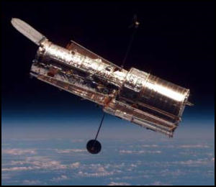
Hubble Telescope
Best known space-based observatory is the Hubble Space Telescope (HST)
Launched in 1990 and still operating today!
Provided us with amazing photos and exciting new information about our galaxy

Slide 19
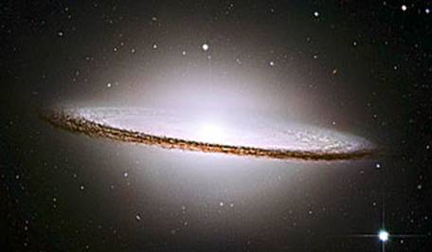
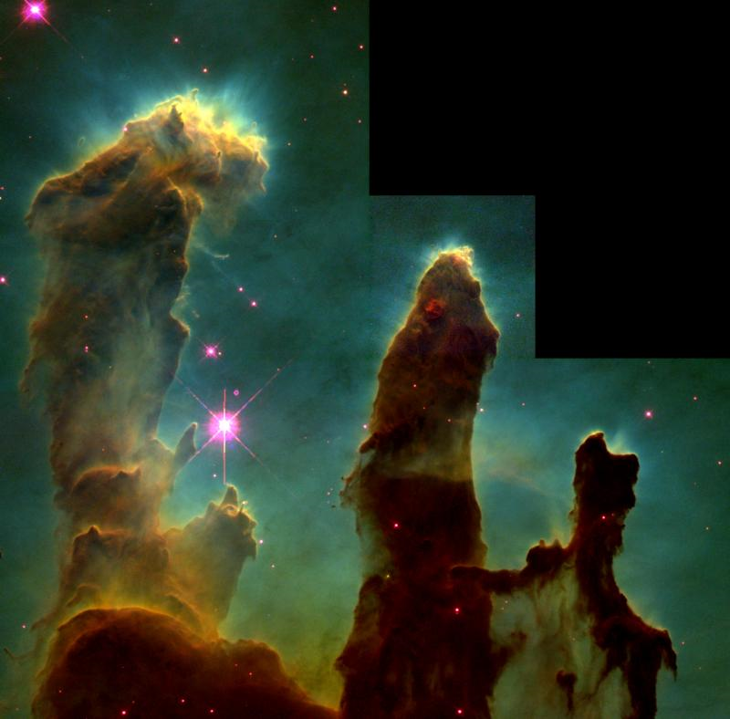
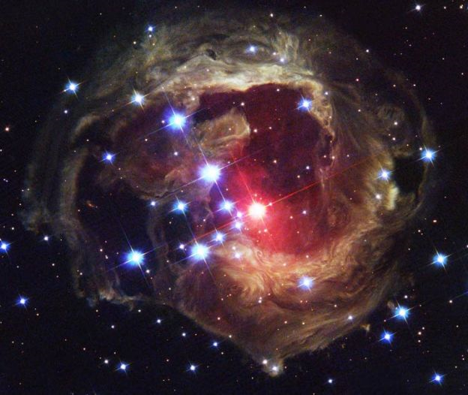
Hubble Images
Top ten images

Slide 20
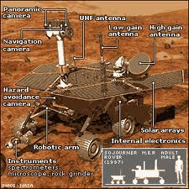
Spacecraft and Probes
Space-based exploration can be accomplished by sending spacecraft or probes directly to the bodies being observed.

Slide 21
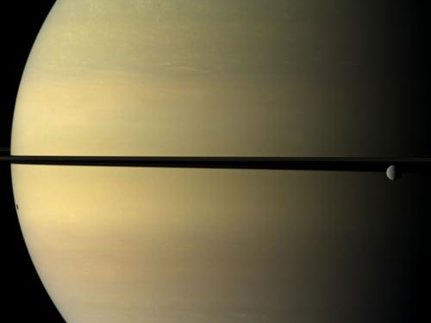
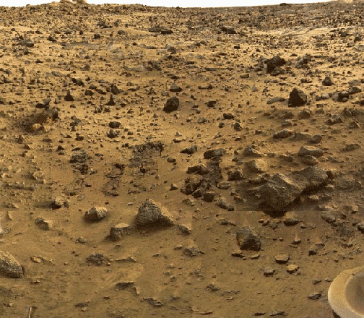
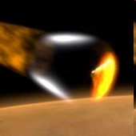
Probe Photos
Moon Rhea orbiting Saturn
Picture of Mars taken by Viking probe

Slide 22
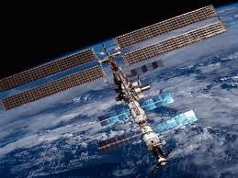
International Space Station
The International Space Station is a multi-country space station that provides an environment to study the effect of weightlessness on plants, humans, and growth of crystals. Human habitation began in 2000.

Slide 23
How do they do it?
Most common questions about astronauts in space:
(1) How do they make food for astronauts?
(2) How do astronauts go to the bathroom in 0G?
(3) How do they train astronauts?

Slide 24
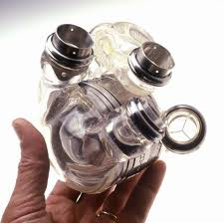
Spin-Offs
Many technologies developed for use in space programs are now used for commercial purposes all over the world.
These are called spin-offs
EX: technology for space shuttle fuel pumps led to development of pumps in artificial hearts

Slide 25
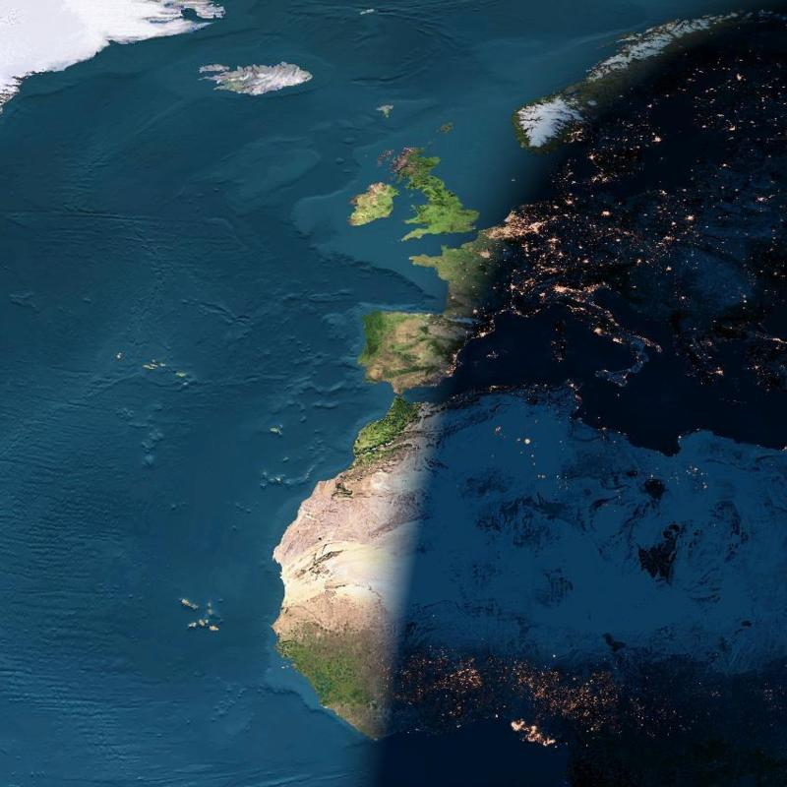
NIGHT ARRIVES BETWEEN EUROPE & AFRICA

Slide 26
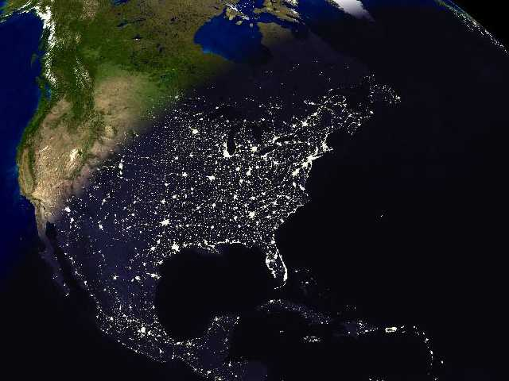
Still daylight in California.
The biggest concentration of lights (from top to bottom) are the cities of Boston, New York, Philadelphia and Washington.

Slide 27
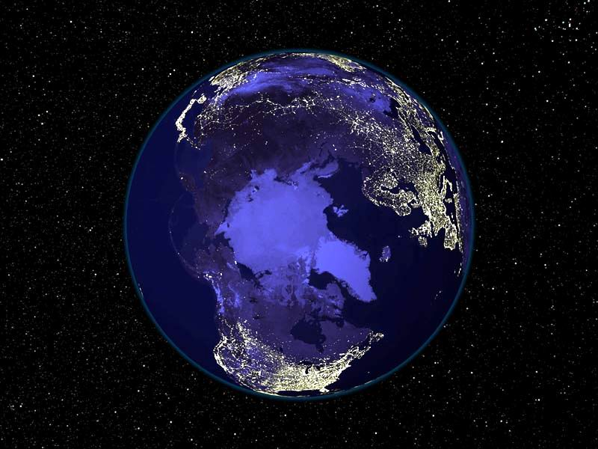
OUR PLANET AT NIGHT

Slide 28
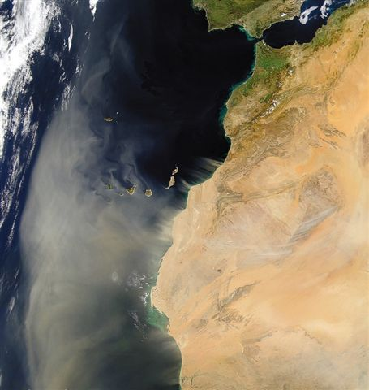
SANDSTORM LEAVING NORTH AFRICA TOWARDS THE ATLANTIC – CANARY ISLAND.

